Slide 1


Leverage Hibernate and Spring Features Together
View Persistence with Hibernate course details at www.edureka.co/persistence-with-hibernate
For Queries:
Post on Twitter @edurekaIN: #askEdureka
Post on Facebook /edurekaIN
For more details please contact us:
US : 1800 275 9730 (toll free)
INDIA : +91 88808 62004
Email Us : webinars@edureka.co

Slide 2
Objectives
At the end of this webinar, you will be able to understand:
What are Hibernate & Spring Frameworks
Advantages of Using Spring and Hibernate Together
Connection Between Hibernate and Spring Frameworks
Spring Transaction Management Using Hibernate
Demo

Slide 3

Hibernate
An Object relational mapping library of java language for Object persistence and SQL databases
Found in 2001 by Gavin King
Transparent persistence of java objects with relational database
Provides query language in synch with SQL
Open source library
Provides solutions for object relational impedance mismatch problems

Slide 4
Persistence using Hibernate
Provides a simple API for storing and retrieving Java objects directly to and from the database
Non-intrusive: No need to follow specific rules or design patterns
Transparent: Your object model is unaware
JavaObject
SQL Table
int id;
String name;
String getName()
int getId()
void setName(String)
id [int] primary key,
name [varchar(50)],
Magic Happens Here
(O/R Mapper – i.e. Hibernate)

Slide 5

Spring
An open source framework
Enables to build applications using POJO (Plain Old Java Objects)
Handles the complete infrastructure required for application from end to end
Makes development of JavaEE (Java EnterPrise Applications) easier
Light weight and transparent
Use of IOC Containers
Supports ORM and Transaction Management

Slide 6
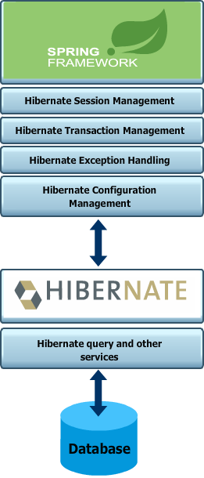
Spring with Hibernate
An extensive support for ORM frameworks like Hibernate , JPA
Provides complete infrastructure for any ORM layer used in the application
IOC of spring handles the SessionFactory instances of hibernate
Configurations of hibernate are taken care efficiently by spring application contexts
Use of hibernate.cfg.xml can be taken care by spring applicationContext.xml
Declarative Transaction management
Built in support for exception handling

Slide 7
Transaction Management with Spring
Spring supports two different approach for transaction management:
Programmatic Transaction Management
Transactions are managed by programming codes
Highly flexible
Difficult in maintenance
Spring TransactionTemplate is used for programmatic approach
Declarative Transaction Management
Transactions are handled declaratively by XML or Annotation
Will have lesser impact with the code of application
Extensive support from Spring AOP
Most widely used

Slide 8
Spring AOP Transaction Management
Spring Aspect Oriented Programming enables to declare transaction declaratively with Aspect
Aspect scatters across methods, class and even objects
Can be used in xml and annotations
AOP declarative transaction:-
Transaction-handling advice is created using <tx:advice/> and pointcut is defined to make transactional advice that matches all methods
Advice begins transaction on before calling the method
On successful execution of method advice commits the transaction
On failure advice rolls back
<tx:advice id="txAdvice"
transaction-manager="transactionManager"> <tx:attributes>
<tx:method name="create"/>
</tx:attributes>
</tx:advice>
<aop:config>
<aop:pointcut id="createOperation" expression="execution(* com.tutorialspoint.StudentJDBCTemplate.create(..))"/>
<aop:advisor advice-ref="txAdvice" pointcut-ref="createOperation"/>
</aop:config>

Slide 9
DEMO : Spring Transaction Management Using Hibernate

Slide 10
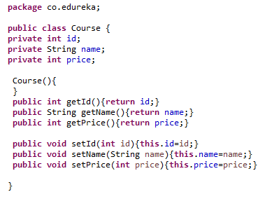
Spring and Hibernate Example
Course class

Slide 11
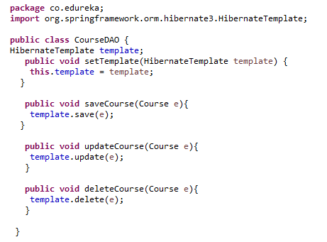
Spring and Hibernate Example (Contd.)
CourseDAO class

Slide 12
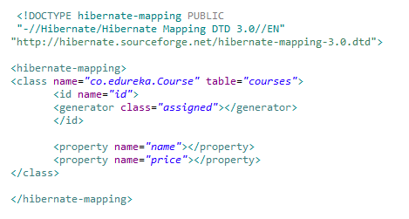
Spring and Hibernate Example (Contd.)
course.hbm.xml
This is the mapping file which will take care of mapping between your Courses table and Course class

Slide 13
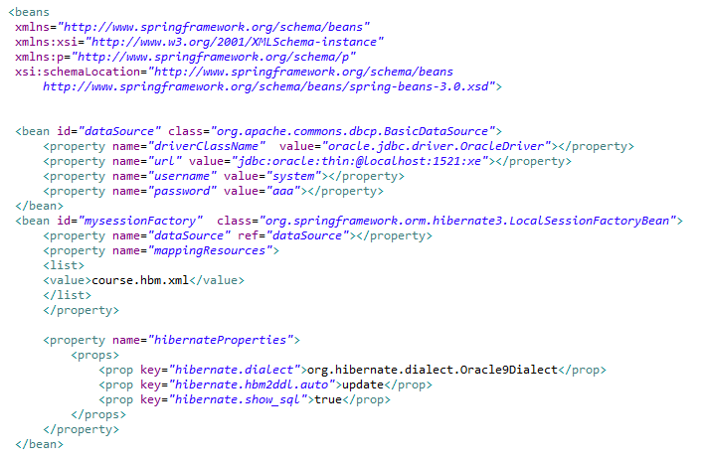
Spring and Hibernate Example (Contd.)
applicationContext.xml (contd.)

Slide 14
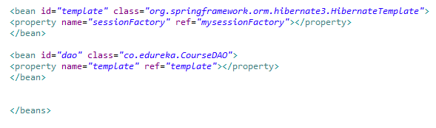
Spring and Hibernate Example (Contd.)
In the applicationContext.xml file we are declaring lots of bean definition
One is for DataSource definition, one is for Hibernate Session Factory with the mapping resource course.hbm.xml
Then we are creating HibernateTemplate bean setting its sessionFactory property to mysessionfactory
Last is the bean definition of CourseDAO class setting its template property to HibernateTemplate bean

Slide 15
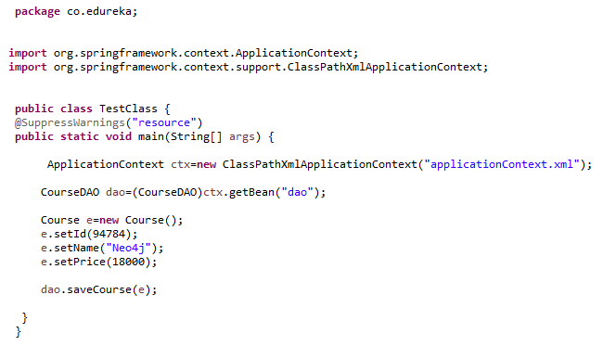
Spring and Hibernate Example (Contd.)
When you run the TestClass, you will see one row in courses table

